Slide 1
Harnessing Marvell Accelerators with Open vSwitch(OVS) Hardware Offload for Accelerated Network Performance 20-21st November 2024 Harman Kalra – Senior Principal Engineer Jerin Jacob – Senior Director

Slide 2
Overview – Open vSwitch (OVS) Hardware Offloading
VM1
VM1
Hardware offload boosts packet processing speed by using specialized hardware, enhancing throughput and minimizing latency
Reduced Host CPU Load: Offloading tasks to the NIC frees up CPU cycles, allowing the host system to handle other critical tasks efficiently
Control stack for dedicated switching hardware
VF Representors represent VFs in OVS, facilitating management and monitoring of network traffic
OVS handles exception packets by classifying them and offloading the flow to dedicated hardware
Subsequent packets match the offloaded flow and take the appropriate actions
VM1
VF Driver
VF Driver
VF Driver
OvS-vSwitchd
dpif-netdev (User space forwarding)
netdev-dpdk
PF PMD
VF representors PMD
RTE Flow
RX/TX Burst
RTE Flow
RX/TX Burst
No Kernel Space Role
PF
VF1
VFn
Flow Classifier/Embedded Switch
Uplink
VM – Virtual Machine
PF- Physical Function
VF – Virtual Function
VF Rep – Virtual Function Representor

Slide 3
Introduction to Marvell Octeon CN10K DPU

Slide 4

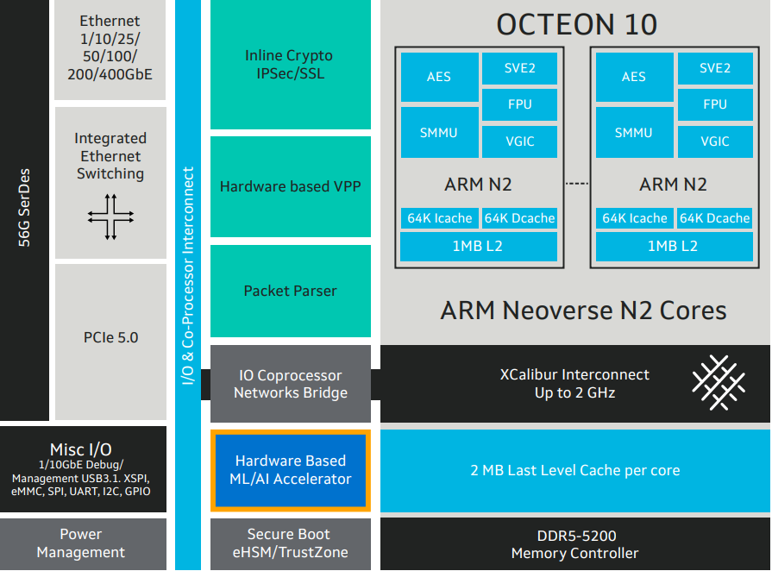
Marvell Octeon CN10K DPU
8 to 24 64-bit ARM Neoverse N2 cores with speeds up to 2.7 GHz
Up to 1 MB L2 per core and total 48 MB LLC cache
Up to 6 DDR5 at 5600 MTS
Integrated 1Terabit switch
Comprehensive hardware accelerators
Hardware ML/AI Acceleration Engine
True inline crypto
Highly programmable packet processors
PCIe DMA Acceleration
Rich set of I/O
PCIe 5.0
Up to 16 x50G ethernet lanes
MACsec support
Up to 56G SerDes lanes

Slide 5

CN10K - Packet Walkthrough – Hardware View
Network Parser and CAM Unit
Network Interface Controller Unit
Add work
Schedule/
Synchronize/Order Unit
(SSO)
Logical MACs 100G,
50G,
40G,
10G,
1G,
PCIe – SDP (System DPI packet interface Unit)
Loopback
Plain
Vector add work
RX
Packet Parser
RSS
RQ0
Encrypt
Key Generation
RQ1
MCAM
RQn
Add packets to CQ ring
NPC-Rx
NIX-Rx
NIX CQ
NPA Buffer
Allocation
Pull packets from CQ ring
Get work
Add work
Plain packet post-decryption
Software buffer alloc/free
ARM Neoverse N2 Cores
Network Pool Allocator
(NPA)
ARM N2
ARM N2
ARM N2
AES
SVE2
Cryptographic Accelerator Unit
SMMU
FPU
Inline
IPsec - RX
IPsec-Rx
CPT
Outbound IPsec-TX
VGIC
IPsec-Tx
64K I cache
64K D cache
Free buffer
to NPA
1MB L2
Network Parser and CAM Unit
Network Interface Controller Unit
Enqueue packets to SQ for Transmit
Packet Parser
Schedulers + Shapers
SQ0
TX
Plain
Key Generation
SQ1
MCAM
SQn
Hardware enqueue/dequeue operation
Encrypt
NPC-Tx
NIX-Tx
Lookaside engines
ML/AI Accelerator
DMA Unit (DPI)
Timer Unit (TIM)
Crypto
(CPT)
Compress
(ZIP)
Regex (REE)

Slide 6
CN10K - Packet Walkthrough – Software View
MKEX/KPU Profile
rte_eth_rx_queue_setup()
rte_event_dev_configure()/
rte_event_queue_setup()
Ethdev Ports
Ethernet MAC
PCIe Host
Loopback
Network Parser and CAM Unit
Network Interface Controller Unit
HW Scheduler
(SSO)
RX
Plain
RSS
Packet Parser
RQ0
Supports both Poll mode and event mode by enabling/disabling scheduler
Encrypt
Key Generation
RQ1
rte_eventdev
MCAM
RQn
rte_flow
rte_ethdev, rte_mtr
NIX CQ
rte_eth_rx_burst()
rte_event_dequeue_burst()
rte_event_enqueue_burst()
rte_mempool_alloc/free()
ARM Neoverse N2 Cores
Network Pool Allocator
(NPA)
ARM N2
ARM N2
rte_security_session_create()
ARM N2
AES
SVE2
Cryptographic Accelerator Unit
SMMU
FPU
IPsec-Rx
CPT
VGIC
rte_mempool
rte_security_set_pkt_metadata()
IPsec-Tx
64K I cache
64K D cache
SW Libraries
rte_mempool_create/destroy()
rte_eth_tx_burst()
1MB L2
EAL
rte_eth_tx_queue_setup()
NPC-Tx
Network Interface Controller Unit
rte_eth_tx_burst()
Ring
Packet Parser
Schedulers + Shapers
SQ0
Mbuf
TX
Plain
Key Generation
SQ1
E.g. Lookaside crypto
rte_cryptodev_en(de)queue_burst()
MCAM
SQn
Hash, LPM,ACL
Encrypt
rte_flow
rte_ethdev, rte_tm
Lookaside engines
(De)Fragmentation
ML/AI
DMA (DPI)
Timer (TIM)
Crypto (CPT)
Compress (ZIP)
Regex (REE)
rte_mldev
rte_event_dma_adapter
rte_event_timer_adapter
rte_cryptodev
rte_compress
rte_regexdev
Pdump

Slide 7
DPDK (Data Plane Development Kit) subsystem mapping
DPDK Subsystem/Library | Abstracted Hardware Controllers/ Accelerators | High-Level Description of APIs
rte_ethdev, rte_event_eth_[rt]x_adapter, | NIX (RPM, SDP, LBK) | Configure the network controller. Set up its RX and TX queues. Start the controller
 |  | Send and Receive packets in poll mode.
 |  | See https://doc.dpdk.org/api/rte__ethdev_8h.html for more information
rte_mempool | NPA | Memory allocation APIs
 |  | See https://doc.dpdk.org/api/rte__mempool_8h.html for more information
rte_flow | NPC | Flow-classification library, program packet-matching and associated actions in hardware through-flow rules.
 |  | See https://doc.dpdk.org/api/rte__flow__classify_8h.html for more information
rte_tm | NIX | Traffic Manager API: Hierarchical scheduling, traffic shaping, congestion-management, packet marking.
 |  | See https://doc.dpdk.org/api/rte__tm_8h.html for more information
rte_cryptodev, rte_event_crypto_adapter | CPT | APIs for provisioning cipher and authentication operations.
 |  | See https://doc.dpdk.org/api/rte__cryptodev_8h.html for more information
rte_security | CPT | A framework for managing and provisioning of security protocol operations offloaded to hardware e.g. IPSEC.
 |  | See https://doc.dpdk.org/api/rte__security_8h.html more information

Slide 8
DPDK (Data Plane Development Kit) subsystem mapping
DPDK Subsystem/Library | Abstracted Hardware Controllers/ Accelerators | High-Level Description of APIs
rte_eventdev | SSO | Support for event-driven programming model; offers applications, automatic multicore scaling, dynamic load-balancing, pipelining, packet ingress order, maintenance and synchronization services to simplify application packet-processing.
 |  | See https://doc.dpdk.org/api/rte__eventdev_8h.html for more information
rte_event_timer_adapter | TIM | Part of the event driver programming model, the timer adapter provides periodic events that can be used in cases like TCP timers.
 |  | See https://doc.dpdk.org/api/rte__event__timer__adapter_8h.html for more information
rte_dmadev, rte_event_dma_adapter | DPI | API allows applications to configure and use generic devices that have no specific type available in the DPDK.I In OCTEON TX2 it can be used for the DMA controller ( DPI).
 |  | See https://doc.dpdk.org/api/rte__dmadev_8h.html for more information
rte_regexdev | REE | Regular Expression (RegEx) Device Library provides a RegEx device framework for management and provisioning of hardware and software.
 |  | See https://doc.dpdk.org/api/rte__regexdev_8h_source.html for more information
rte_mldev | ML | Machine Learning (ML) Device Library provides a Machine Learning device framework which support a number of ML operations including device handling and inference processing.
 |  | See https://doc.dpdk.org/api/rte__mldev_8h.html for more information

Slide 9
Leveraging OVS offloading capability with Marvell Octeon CN10K DPU

Slide 10
Design Paradigm
Lower CPU Utilization
Free up CPU resources for other tasks, improving overall system efficiency
No Custom changes to OVS
Implement solutions without custom changes to OVS ensuring seamless integration of standard frameworks on Marvell platforms
Addressing Hardware Constraints
Mitigate hardware limitations through optimized software implementation that enhance overall functionality
Seamless Configuration
Utilize standard OVS utilities and network automation to simplify network configuration and management
OVS processes the initial packets and offloads the flow to hardware, enabling subsequent packets to be handled via fast path through hardware lookup
Optimizing Packet Processing
Maximize Hardware Utilization
Maximize hardware accelerators utilization by integrating with OVS hardware offloading features
© 2024 Marvell. All rights reserved.

Slide 11
Navigating Packet Flow

Slide 12
VM1 to VMn
Wire to VM1
First packet from wire is received by all VMs as result of ARP broadcast.
First packet from VM1 is steered to OVS for classification and flow offloading to the hardware.
Kernel VFm to Wire
VF port not part of ovs-offload application communicates with its respective OVS representor port HW via HW loopback block.
Tunnel Transfer
Subsequent packets hit the offloaded flow and reach VM1 directly.
Destined VM replies and gets the respective flow offloaded to hardware via OVS.
First packet from VMn undergoes encapsulation by OVS and same flow gets offloaded.
On reception OVS decapsulates the packet and steers the plain packet to VMn.
VM to VM Exception Path
VM to VM Fast Path
X86/ARM
Host
Wire to VM Exception path
Wire to VM Fast path
VM1
VMn
Native VF to Wire Exception path
Native VF to Wire Fast path
Tunneling exception path VM to wire
Tunneling Fast path VM to wire
OCTEON
Match1 | Action1
NIX + NPC
Match3 | Action2
VMm
Match2 | Action2
Match4 | Action4
VFm-Rep
SDP VF1
SDP VFn
OVS
OVS-Offload-Engine
Match | Action
Match1 | Action1
matchN | actionN
Flow Decoder
Encapsulation/Decapsulation Unit
NIX-PF
VF1-Rep
VFn-Rep
NIX VF1
NIX VFn
Match1 | Action1
Match3 | Action2
NIX + NPC
Match2 | Action2
Match4 | Action4
Port
© 2024 Marvell. All rights reserved.

Slide 13
Feature Scaling with Modular DAO (Data Accelerator Offload) Components

Slide 14

VM1
VM2
X86/ARM Host
PCIe
Flow/ Connection Aging
Flow Cascading
Match | Action
Match1 | Action1
Match | Action
Match1 | Action1
Stateful/Stateless protocol tracking
Match | Action
Match1 | Action1
Flow Offloading to Hardware
Connection State Management
Connection Management
NIX + NPC
Connection Tracking Library
Match1 | Action1
Flow Library
DAO Components
Packet Tunneling (VxLAN, Geneve, GRE)
Flow Management
Encapsulation/Decapsulation Unit
Ofproto/
Datpath Classifier
Packet Classification
Hardware Offloading
VLAN Tagging
Flow Decoder
MAC Learning
Header Transformation​
OVS
OVS-Offload-Engine
Packet Transformation Library
PF
V1-Rep
V2-Rep
NIX + NPC
Packet Flow
Configuration Flow
Match1 | Action1
Exception Path
Flow Management
OCTEON
Port
Fast Path
Packet Manipulation
Ethernet
Connection Management
© 2024 Marvell. All rights reserved.

Slide 15
Challenges
Challenges
Mitigations
Certain protocols and actions not supported by the hardware
Optimized Software implementation for unsupported protocols and actions via DAO Flow library
Packets cannot be relayed directly from the host PCIe to Ethernet interface due to a lack of direct connectivity
OVS offload engine forwards packets between the host and Ethernet interfaces.
Small fraction of ARM cores is utilized to perform software tasks as part of the solution
Working on optimizing the ARM core utilization and offloading it to the hardware in future platforms
CN10K DPDK driver crashes when transmission is initiated from a non-pmd thread which carries an invalid lcore_id
Custom OVS change where a non-pmd thread registers for a valid lcore_id before transmission and deregister back on completion
No support for connection tracking offloads for DPDK provider
Enhancing OVS connection tracking for DPDK providers using rte_flow’s connection tracking capabilities

Slide 16
Solution Milestones
Completed
Ongoing
Planned
Plain packet Switching Between Host VMs and outside network
Hardware offloading for VLAN tagged traffic
Tunnel Offloading with Optimized Software
Connection Tracking DAO Library
Advanced Flow management via DAO Flow library
HW offloads enablement in OVS
Flow offloading and aging
QoS
IPsec
Cascaded flows
Connection tracking offload for DPDK provider

Slide 17
Summary
OVS HW offload feature improves system performance significantly
Synergizing Hardware and Software for Accelerated Packet Processing and Switching
Extra ARM cores available for business logic
Seamless integration with standard frameworks such as OpenShift, OVN
Feature Scaling with Modular DAO Libraries
Reusable solution for upcoming SoC

